Slide 1
Advent Assembly PowerPoint
Running time: 2m 45s
Sound required.
Click to start. Do not press click again.

Slide 2

The church’s year has come to an end . . .
. . . and a new year begins.
The mood changes from celebration and hope . . .
. . . to preparation and expectation.
Green changes . . .
. . . to purple.

Slide 3
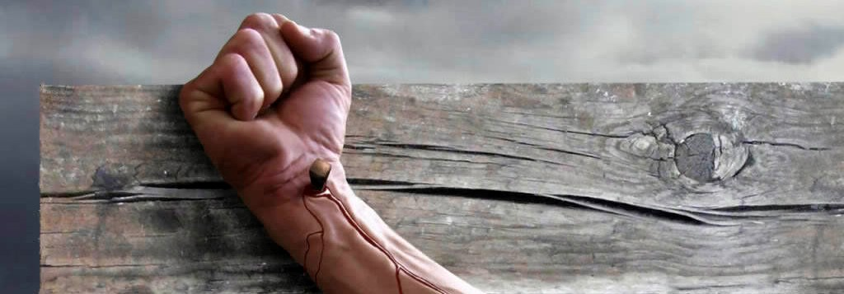
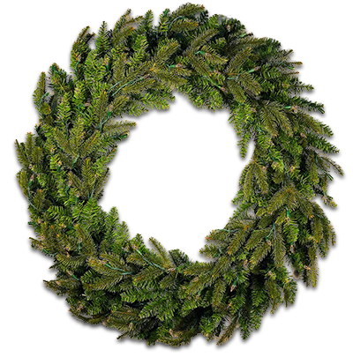

The red berries represent the blood that Jesus will shed on the cross.
The circle of the wreath represents the eternity of God’s love.
This is Advent
The symbol of Advent is the Advent wreath
The red ribbon represents the blood that flowed from Jesus’ side.

Slide 4
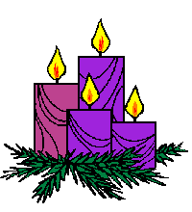
The four candles represent the four weeks of Advent
On each Sunday of Advent
another candle is lit.
As Christmas comes closer
the light grows.
Christ is the
light of the world.

Slide 5
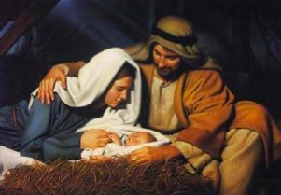
Emmanuel
is the name we use for Jesus
at this time of year.
Emmanuel means
‘God is with us.’
O come, O come, Emmanuel,
and cheer our spirits
by thine advent here.

Slide 6
“An angel
appeared to Joseph in a dream
and said:
‘Do not be afraid to take Mary home as your wife.
She will give birth to a son
and you must name him Jesus,
because he is the one who is to save his people.’
The virgin will conceive
and give birth to a son
and they will call him
Emmanuel.”
The Gospel of St Matthew, chapter 1

Slide 7

ADVENT

